Slide 1

EXPQuest
Jo, Devin, Alex

Slide 2
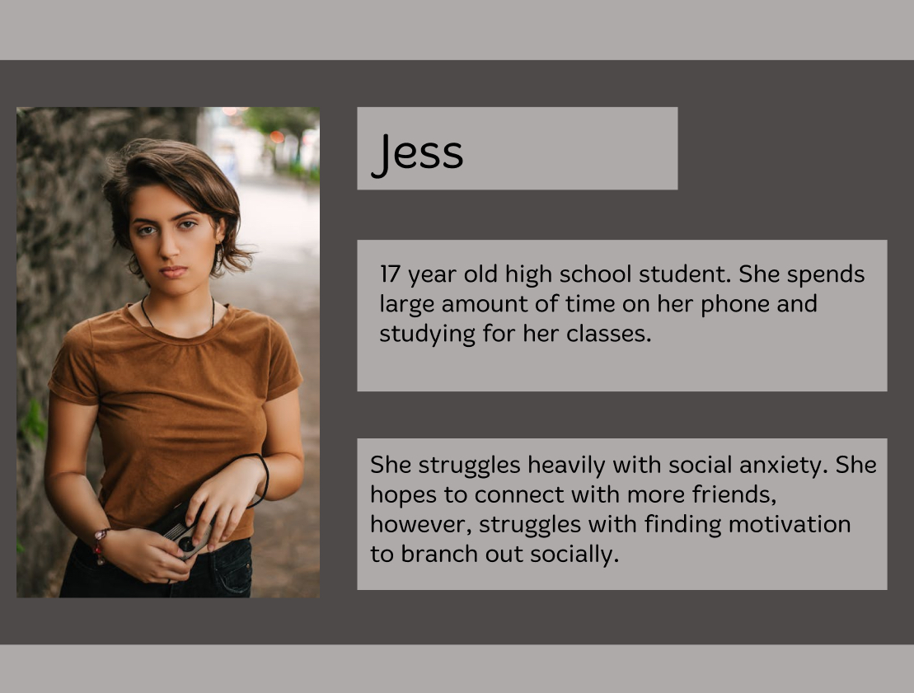
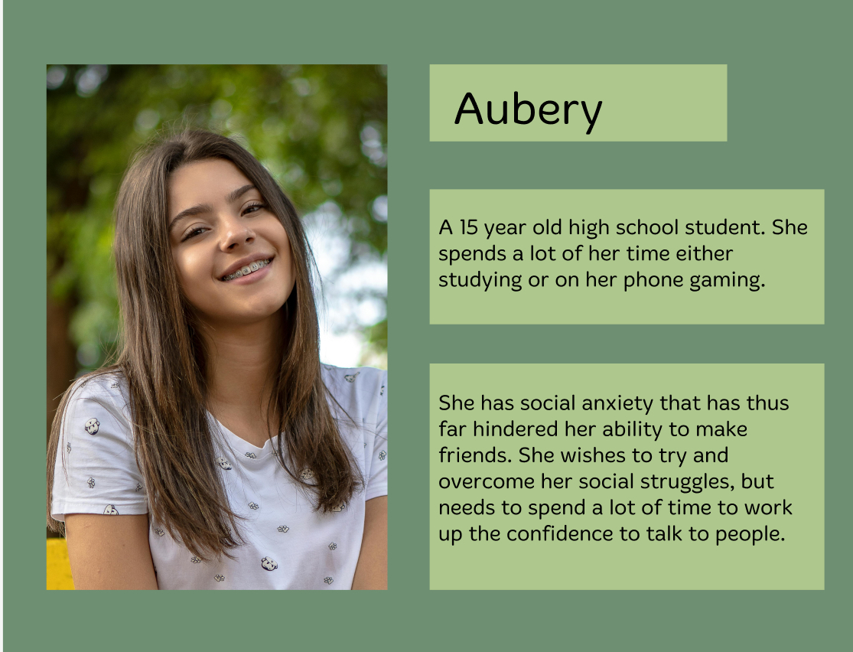
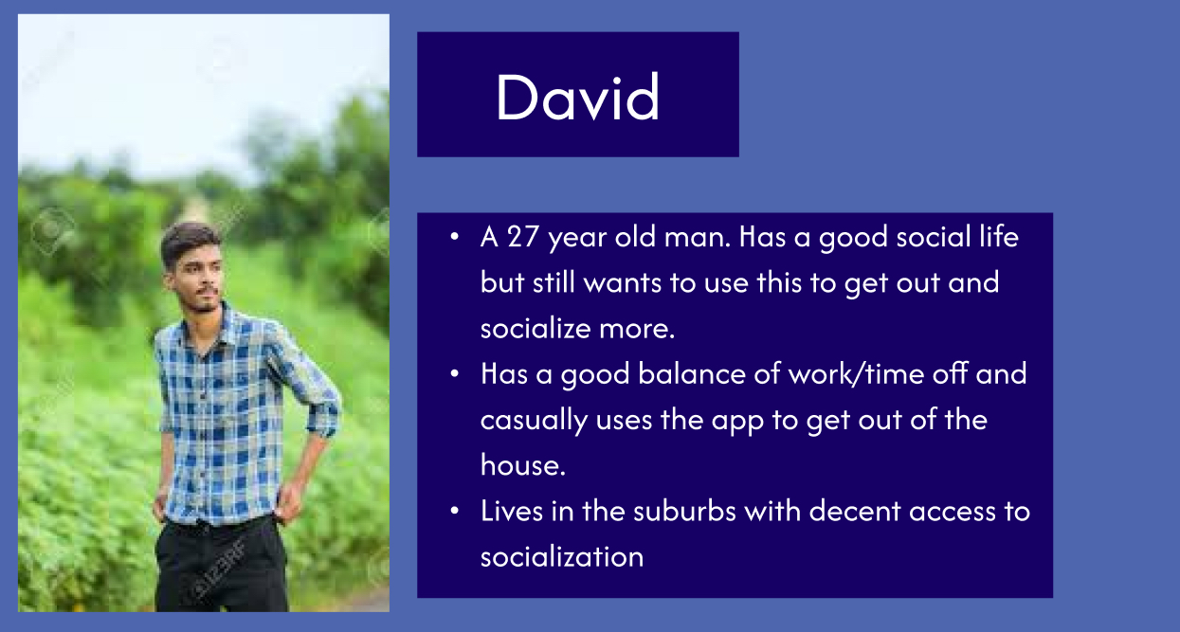
Introduction & Problem
EXPQuest - Works to combat social anxiety
Target Audience: Teens and young adults that struggle with social anxiety
Average User
Power User
Casual User

Slide 3
Design Evolution
EXPQuest from Group 1 of Section 5
Feedback:
Minor changes UI
New feature that allows user to kill villagers

Slide 4
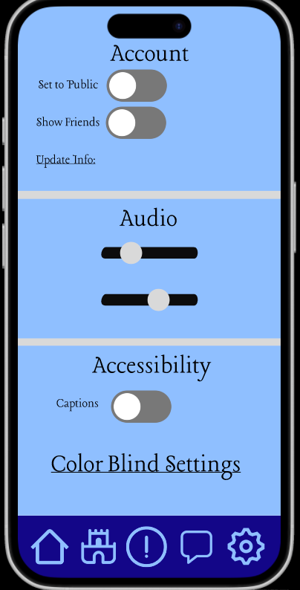
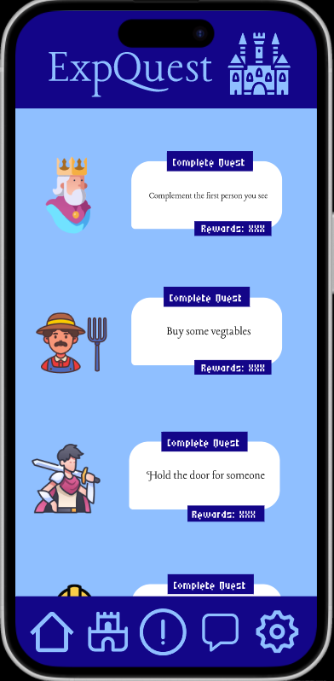
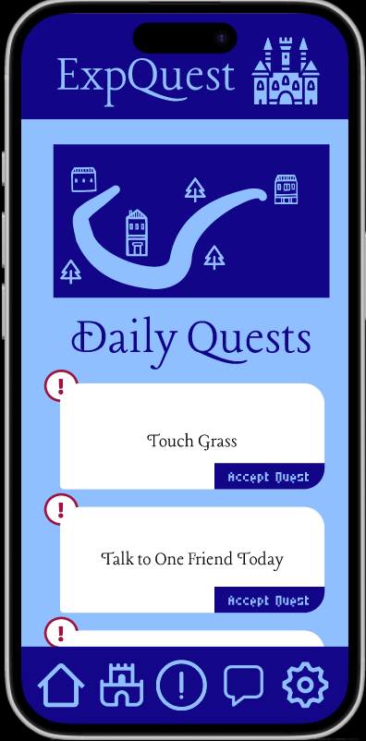
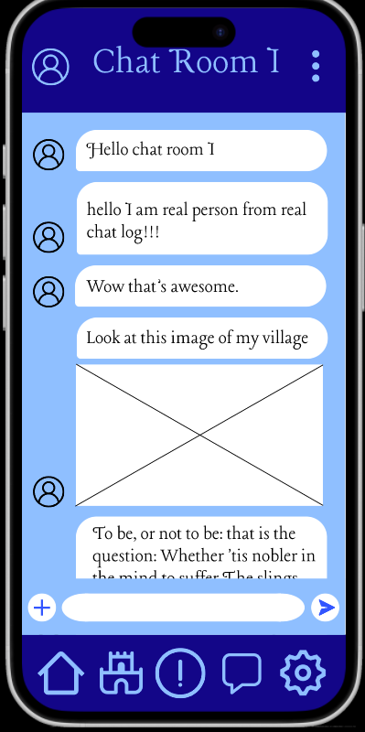
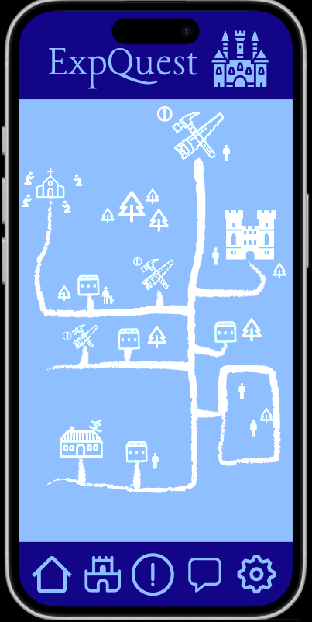
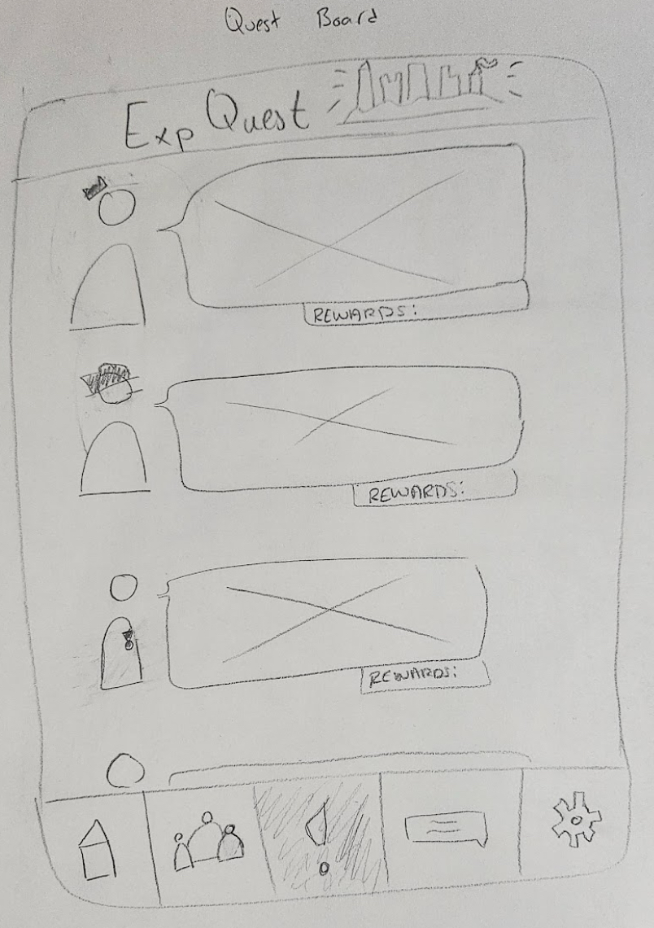
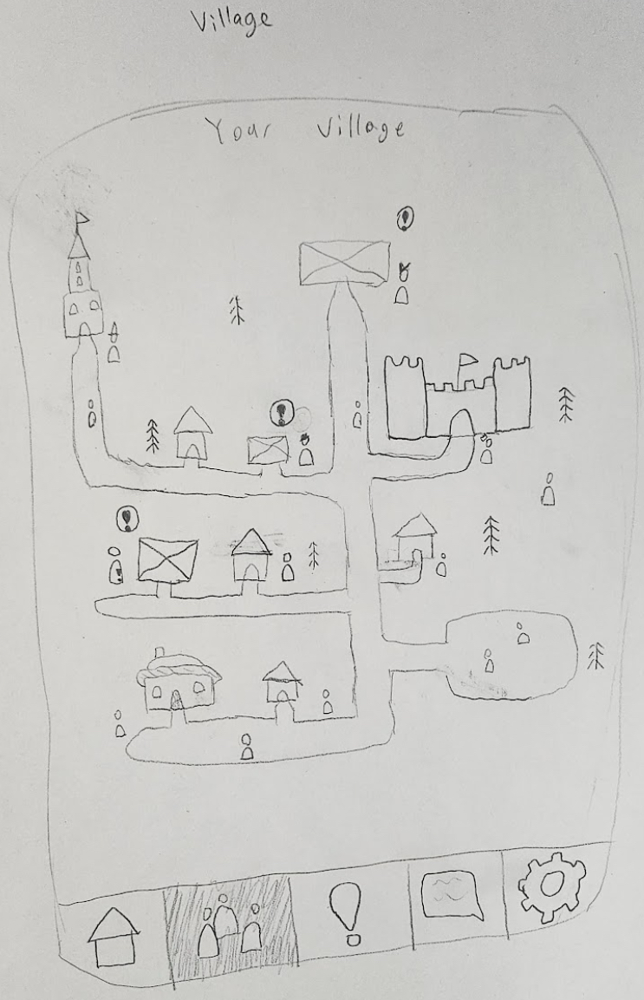
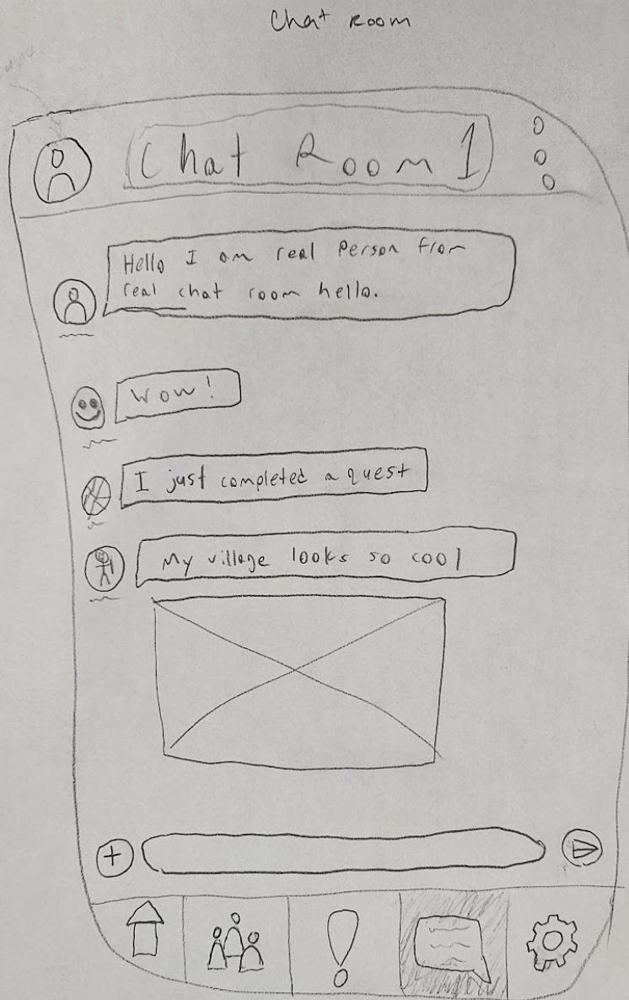
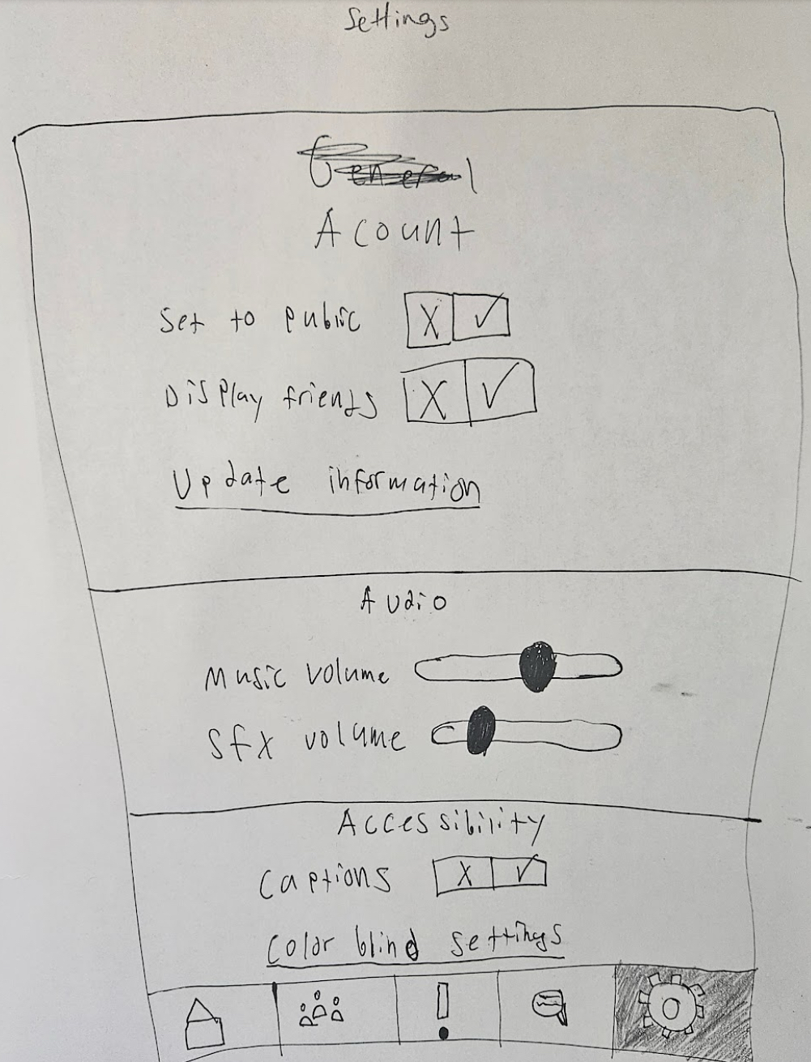
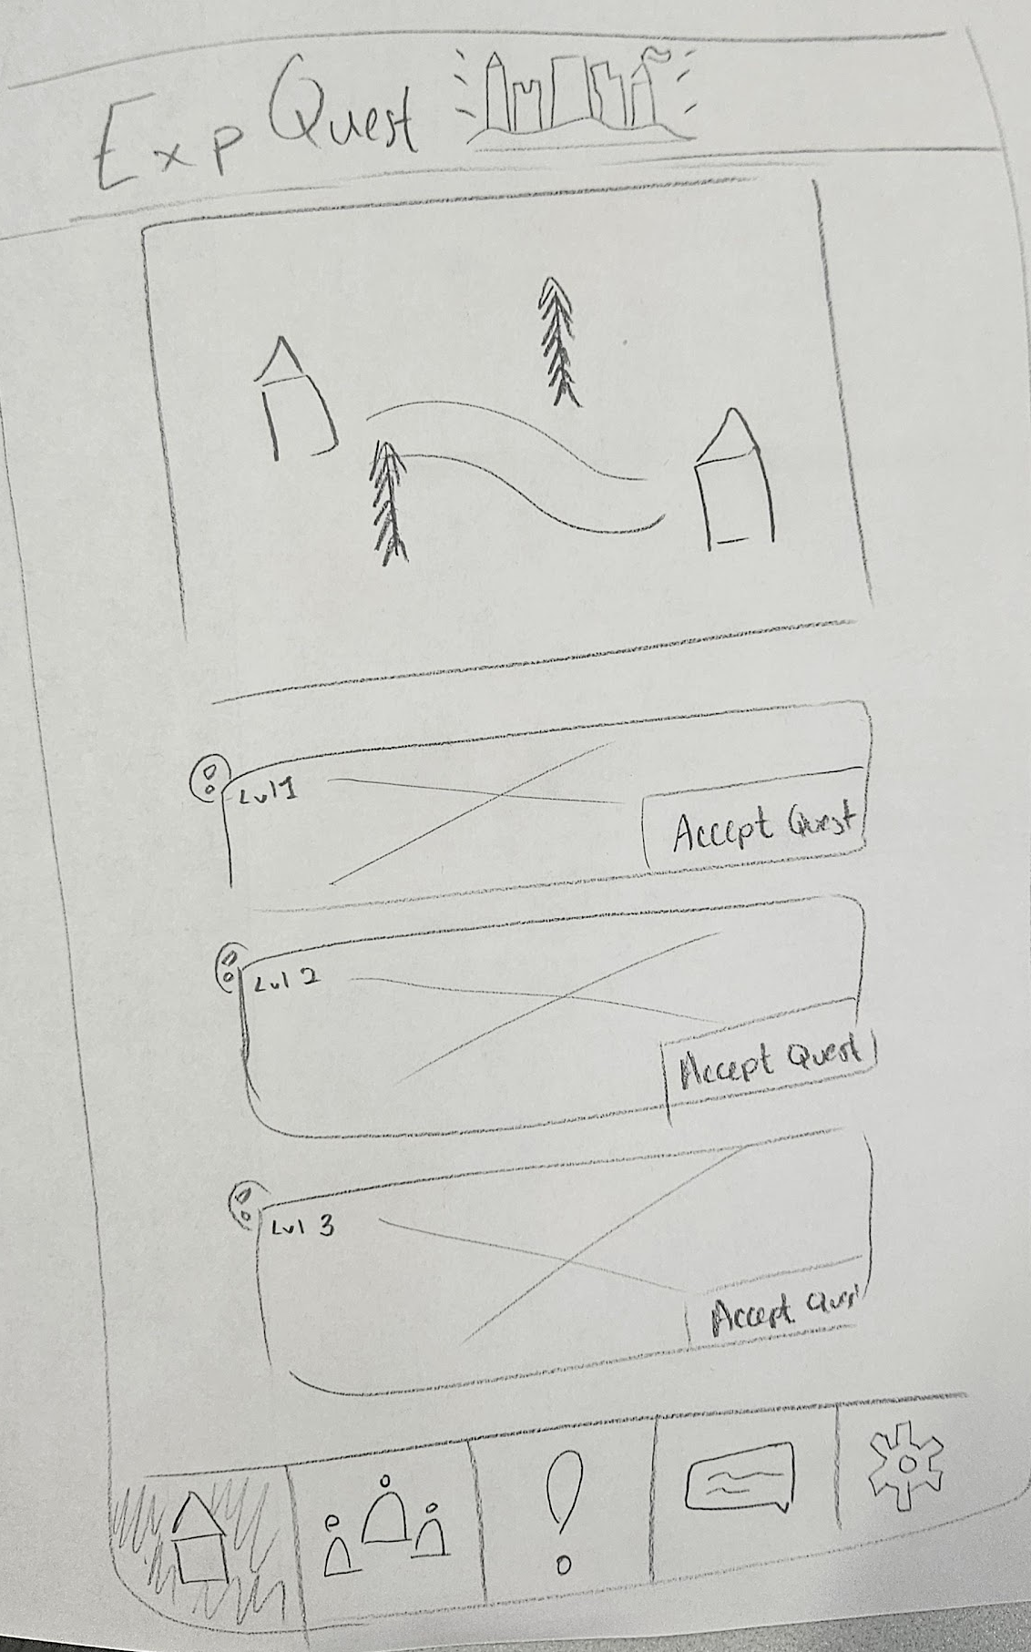
High-Fi
Low-Fi

Slide 5
Live Demo
https://www.figma.com/proto/vbn3zOjQmTd192NxnXdfBn/Hi-Fi-Prototype---Deliverable--3?node-id=1-3&p=f&t=mzYseyn4HFzdOtGF-0&scaling=scale-down&content-scaling=fixed&page-id=0%3A1&starting-point-node-id=1%3A4&show-proto-sidebar=1

Slide 6
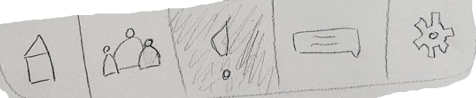

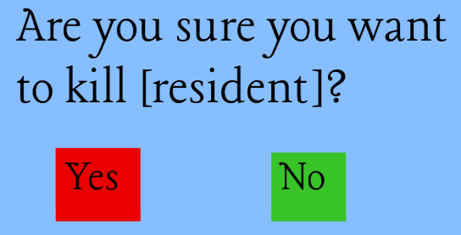
Testing & Iteration
Navigation bar was misleading, so we added simple to understand icons
Testing users pitched the wonderful idea of killing villagers!

Slide 7
Conclusion
Traditional methods of dealing with social anxiety can be overwhelming and difficult.
EXPQuest changes that.

